Slide 1
Assembly Language for x86 Processors 7th Edition
Kip R. Irvine
Chapter 6: Conditional Processing
(c) Pearson Education, 2015. All rights reserved. You may modify and copy this slide show for your personal use, or for use in the classroom, as long as this copyright statement, the author's name, and the title are not changed.

Slide 2
Chapter Overview
Boolean and Comparison Instructions
Conditional Jumps
Conditional Loop Instructions
Conditional Structures
Application: Finite-State Machines
Conditional Control Flow Directives
Irvine, Kip R. Assembly Language for x86 Processors 7/e, 2015.

Slide 3
Boolean and Comparison Instructions
CPU Status Flags
AND Instruction
OR Instruction
XOR Instruction
NOT Instruction
Applications
TEST Instruction
CMP Instruction
Irvine, Kip R. Assembly Language for x86 Processors 7/e, 2015.

Slide 4
Status Flags - Review
The Zero flag is set when the result of an operation equals zero.
The Carry flag is set when an instruction generates a result that is too large (or too small) for the destination operand.
The Sign flag is set if the destination operand is negative, and it is clear if the destination operand is positive.
The Overflow flag is set when an instruction generates an invalid signed result (bit 7 carry is XORed with bit 6 Carry).
The Parity flag is set when an instruction generates an even number of 1 bits in the low byte of the destination operand.
The Auxiliary Carry flag is set when an operation produces a carry out from bit 3 to bit 4
Irvine, Kip R. Assembly Language for x86 Processors 7/e, 2015.

Slide 5


AND Instruction
Performs a Boolean AND operation between each pair of matching bits in two operands
Syntax:
    AND destination, source
  (same operand types as MOV)
AND
Irvine, Kip R. Assembly Language for x86 Processors 7/e, 2015.

Slide 6


OR Instruction
Performs a Boolean OR operation between each pair of matching bits in two operands
Syntax:
    OR destination, source
OR
Irvine, Kip R. Assembly Language for x86 Processors 7/e, 2015.

Slide 7

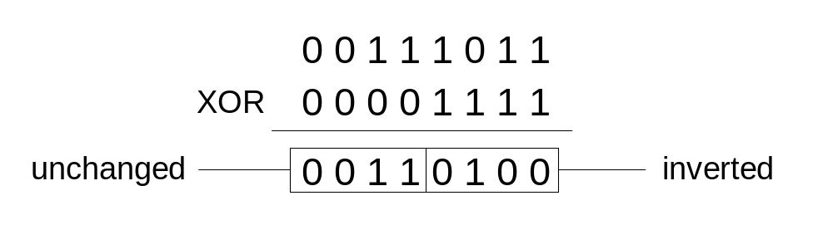
XOR Instruction
Performs a Boolean exclusive-OR operation between each pair of matching bits in two operands
Syntax:
    XOR destination, source
XOR
XOR is a useful way to toggle (invert) the bits in an operand.
Irvine, Kip R. Assembly Language for x86 Processors 7/e, 2015.

Slide 8

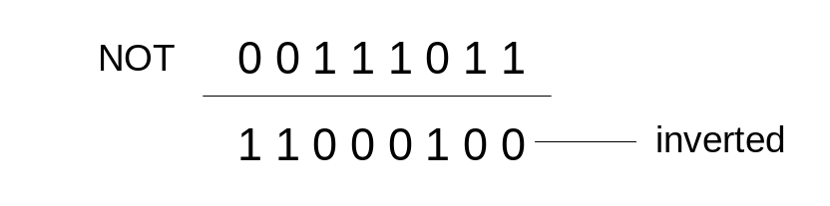
NOT Instruction
Performs a Boolean NOT operation on a single destination operand
Syntax:
    NOT destination
NOT
Irvine, Kip R. Assembly Language for x86 Processors 7/e, 2015.

Slide 9
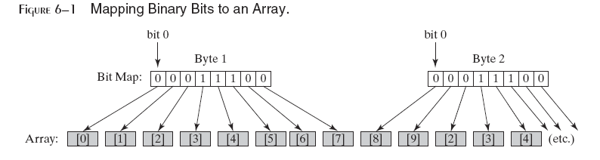
Bit-Mapped Sets
Binary bits indicate set membership
Efficient use of storage
Also known as bit vectors
Irvine, Kip R. Assembly Language for x86 Processors 7/e, 2015.

Slide 10
Bit-Mapped Set Operations
Set Complement 补集
    mov eax,SetX
    not eax
Set Intersection 交集
    mov eax,setX
    and eax,setY
Set Union 并集
    mov eax,setX
    or eax,setY
Irvine, Kip R. Assembly Language for x86 Processors 7/e, 2015.

Slide 11
Applications (1 of 5)
Task: Convert the character in AL to upper case.
Solution: Use the AND instruction to clear bit 5.
mov al,'a' ; AL = 01100001b
and al,11011111b ; AL = 01000001b
Irvine, Kip R. Assembly Language for x86 Processors 7/e, 2015.

Slide 12
Applications (2 of 5)
Task: Convert a binary decimal byte into its equivalent ASCII decimal digit.
Solution: Use the OR instruction to set bits 4 and 5.
mov al,6 ; AL = 00000110b
or al,00110000b ; AL = 00110110b
The ASCII digit '6' = 00110110b
Irvine, Kip R. Assembly Language for x86 Processors 7/e, 2015.

Slide 13
Applications (3 of 5)
Task: Turn on the keyboard CapsLock key
Solution: Use the OR instruction to set bit 6 in the keyboard flag byte at 0040:0017h in the BIOS data area.
mov ax,40h ; BIOS segment
mov ds,ax
mov bx,17h ; keyboard flag byte
or BYTE PTR [bx],01000000b ; CapsLock on
This code only runs in Real-address mode, and it does not work under Windows NT, 2000, or XP.
Irvine, Kip R. Assembly Language for x86 Processors 7/e, 2015.

Slide 14
Applications (4 of 5)
Task: Jump to a label if an integer is even.
Solution: AND the lowest bit with a 1. If the result is Zero, the number was even.
mov ax,wordVal
and ax,1 ; low bit set?
jz EvenValue ; jump if Zero flag set
JZ (jump if Zero) is covered in Section 6.3.
Your turn: Write code that jumps to a label if an integer is negative.
Irvine, Kip R. Assembly Language for x86 Processors 7/e, 2015.

Slide 15
Applications (5 of 5)
Task: Jump to a label if the value in AL is not zero.
Solution: OR the byte with itself, then use the JNZ (jump if not zero) instruction.
or al,al
jnz IsNotZero ; jump if not zero
ORing any number with itself does not change its value.
Irvine, Kip R. Assembly Language for x86 Processors 7/e, 2015.

Slide 16
TEST Instruction
Performs a nondestructive AND operation between each pair of matching bits in two operands
No operands are modified, but the Zero flag is affected.
Example: jump to a label if either bit 0 or bit 1 in AL is set.
test al,00000011b
jnz ValueFound （ZF=0）
Example: jump to a label if neither bit 0 nor bit 1 in AL is set.
test al,00000011b
jz ValueNotFound (ZF=1)
Irvine, Kip R. Assembly Language for x86 Processors 7/e, 2015.

Slide 17
CMP Instruction (1 of 3)
Compares the destination operand to the source operand
  Nondestructive subtraction of source from destination (destination operand is not changed)
Syntax: CMP destination, source
Example: destination == source
mov al,5
cmp al,5 ; Zero flag set
Example: destination < source
mov al,4
cmp al,5 ; Carry flag set
Irvine, Kip R. Assembly Language for x86 Processors 7/e, 2015.

Slide 18
CMP Instruction (2 of 3)
Example: destination > source
mov al,6
cmp al,5 ; ZF = 0, CF = 0
(both the Zero and Carry flags are clear)
Irvine, Kip R. Assembly Language for x86 Processors 7/e, 2015.

Slide 19
CMP Instruction (3 of 3)
The comparisons shown here are performed with signed integers.
Example: destination > source
mov al,5
cmp al,-2 ; Sign flag == Overflow flag
Example: destination < source
mov al,-1
cmp al,5 ; Sign flag != Overflow flag
Irvine, Kip R. Assembly Language for x86 Processors 7/e, 2015.

Slide 20
Boolean Instructions in 64-Bit Mode
64-bit boolean instructions, for the most part, work the same as 32-bit instructions
If the source operand is a constant whose size is less than 32 bits and the destination is the lower part of a 64-bit register or memory operand, all bits in the destination operand are affected
When the source is a 32-bit constant or register, only the lower 32 bits of the destination operand are affected
Irvine, Kip R. Assembly Language for x86 Processors 7/e, 2015.

Slide 21
What's Next
Boolean and Comparison Instructions
Conditional Jumps
Conditional Loop Instructions
Conditional Structures
Application: Finite-State Machines
Conditional Control Flow Directives
Irvine, Kip R. Assembly Language for x86 Processors 7/e, 2015.

Slide 22
Conditional Jumps
Jumps Based On . . .
  Specific flags
  Equality
  Unsigned comparisons
  Signed Comparisons
Applications
Encrypting a String
Bit Test (BT) Instruction
Irvine, Kip R. Assembly Language for x86 Processors 7/e, 2015.

Slide 23
Jcond Instruction
A conditional jump instruction branches to a label when specific register or flag conditions are met
Specific jumps:
  JB, JC - jump to a label if the Carry flag is set
  JE, JZ - jump to a label if the Zero flag is set
  JS - jump to a label if the Sign flag is set
  JNE, JNZ - jump to a label if the Zero flag is clear
  JECXZ - jump to a label if ECX = 0
Irvine, Kip R. Assembly Language for x86 Processors 7/e, 2015.

Slide 24
Jcond Ranges
Prior to the 386:
  jump must be within –128 to +127 bytes from current location counter
x86 processors:
  32-bit offset permits jump anywhere in memory
Irvine, Kip R. Assembly Language for x86 Processors 7/e, 2015.

Slide 25
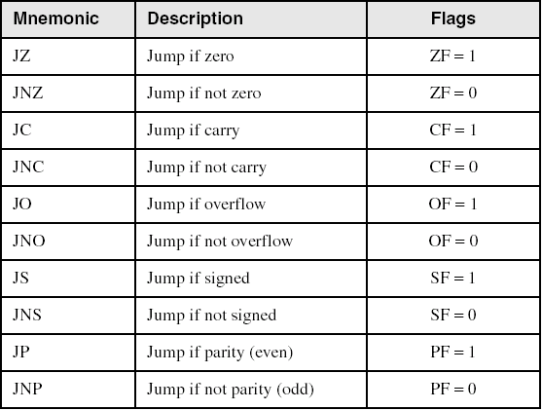
Jumps Based on Specific Flags
Irvine, Kip R. Assembly Language for x86 Processors 7/e, 2015.

Slide 26
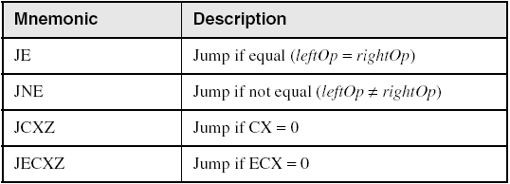
Jumps Based on Equality
Irvine, Kip R. Assembly Language for x86 Processors 7/e, 2015.

Slide 27
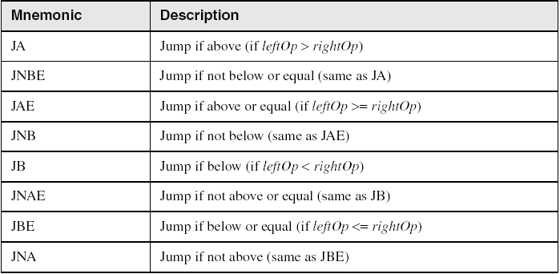
Jumps Based on Unsigned Comparisons
Irvine, Kip R. Assembly Language for x86 Processors 7/e, 2015.

Slide 28
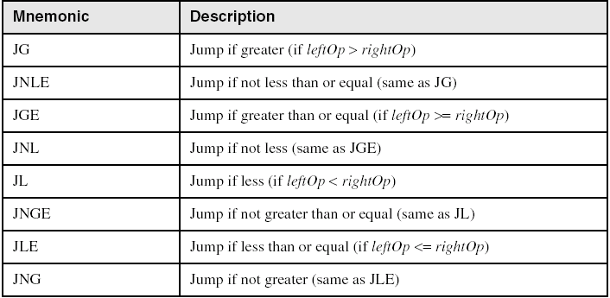
Jumps Based on Signed Comparisons
Irvine, Kip R. Assembly Language for x86 Processors 7/e, 2015.

Slide 29
Applications (1 of 5)
Task: Jump to a label if unsigned EAX is greater than EBX
Solution: Use CMP, followed by JA
cmp eax,ebx
ja Larger
Task: Jump to a label if signed EAX is greater than EBX
Solution: Use CMP, followed by JG
cmp eax,ebx
jg Greater
Irvine, Kip R. Assembly Language for x86 Processors 7/e, 2015.

Slide 30
Applications (2 of 5)
Jump to label L1 if unsigned EAX is less than or equal to Val1
cmp eax,Val1
jbe L1 ; below or equal
Jump to label L1 if signed EAX is less than or equal to Val1
cmp eax,Val1
jle L1
Irvine, Kip R. Assembly Language for x86 Processors 7/e, 2015.

Slide 31
Applications (3 of 5)
Compare unsigned AX to BX, and copy the larger of the two into a variable named Large
  mov Large,bx
  cmp ax,bx
  jna Next
  mov Large,ax
Next:
Compare signed AX to BX, and copy the smaller of the two into a variable named Small
  mov Small,ax
  cmp bx,ax
  jnl Next
  mov Small,bx
Next:
Irvine, Kip R. Assembly Language for x86 Processors 7/e, 2015.

Slide 32
Applications (4 of 5)
Jump to label L1 if the memory word pointed to by ESI equals Zero
  cmp WORD PTR [esi],0
  je L1
Jump to label L2 if the doubleword in memory pointed to by EDI is even
test DWORD PTR [edi],1
jz L2
Irvine, Kip R. Assembly Language for x86 Processors 7/e, 2015.

Slide 33
Applications (5 of 5)
Task: Jump to label L1 if bits 0, 1, and 3 in AL are all set.
Solution: Clear all bits except bits 0, 1,and 3. Then compare the result with 00001011 binary.
and al,00001011b ; clear unwanted bits
cmp al,00001011b ; check remaining bits
je L1 ; all set? jump to L1
Irvine, Kip R. Assembly Language for x86 Processors 7/e, 2015.

Slide 34
Your turn . . .
Write code that jumps to label L1 if either bit 4, 5, or 6 is set in the BL register.
Write code that jumps to label L1 if bits 4, 5, and 6 are all set in the BL register.
Write code that jumps to label L2 if AL has even parity.
Write code that jumps to label L3 if EAX is negative.
Write code that jumps to label L4 if the expression (EBX – ECX) is greater than zero.
Irvine, Kip R. Assembly Language for x86 Processors 7/e, 2015.

Slide 35
Encrypting a String
The following loop uses the XOR instruction to transform every character in a string into a new value.
KEY = 239 ; can be any byte value
BUFMAX = 128
.data
buffer BYTE BUFMAX+1 DUP(0)
bufSize DWORD BUFMAX
.code
  mov ecx,bufSize ; loop counter
  mov esi,0 ; index 0 in buffer
L1:
  xor buffer[esi],KEY ; translate a byte
  inc esi ; point to next byte
  loop L1
Irvine, Kip R. Assembly Language for x86 Processors 7/e, 2015.

Slide 36
String Encryption Program
Tasks:
  Input a message (string) from the user
  Encrypt the message
  Display the encrypted message
  Decrypt the message
  Display the decrypted message
View the Encrypt.asm program's source code. Sample output:
Enter the plain text: Attack at dawn.
Cipher text: «¢¢Äîä-Ä¢-ïÄÿü-Gs
Decrypted: Attack at dawn.
Irvine, Kip R. Assembly Language for x86 Processors 7/e, 2015.

Slide 37
BT (Bit Test) Instruction
Copies bit n from an operand into the Carry flag
Syntax: BT bitBase, n
  bitBase may be r/m16 or r/m32
  n may be r16, r32, or imm8
Example: jump to label L1 if bit 9 is set in the AX register:
bt AX,9 ; CF = bit 9
jc L1 ; jump if Carry
Irvine, Kip R. Assembly Language for x86 Processors 7/e, 2015.

Slide 38
What's Next
Boolean and Comparison Instructions
Conditional Jumps
Conditional Loop Instructions
Conditional Structures
Application: Finite-State Machines
Conditional Control Flow Directives
Irvine, Kip R. Assembly Language for x86 Processors 7/e, 2015.

Slide 39
Conditional Loop Instructions
LOOPZ and LOOPE
LOOPNZ and LOOPNE
Irvine, Kip R. Assembly Language for x86 Processors 7/e, 2015.

Slide 40
LOOPZ and LOOPE
Syntax:
  LOOPE destination
  LOOPZ destination
Logic:
  ECX ← ECX – 1
  if ECX > 0 and ZF=1, jump to destination
Useful when scanning an array for the first element that does not match a given value.
In 32-bit mode, ECX is the loop counter register. In 16-bit real-address mode, CX is the counter, and in 64-bit mode, RCX is the counter.
Irvine, Kip R. Assembly Language for x86 Processors 7/e, 2015.

Slide 41
LOOPNZ and LOOPNE
LOOPNZ (LOOPNE) is a conditional loop instruction
Syntax:
LOOPNZ destination
LOOPNE destination
Logic:
  ECX ← ECX – 1;
  if ECX > 0 and ZF=0, jump to destination
Useful when scanning an array for the first element that matches a given value.
Irvine, Kip R. Assembly Language for x86 Processors 7/e, 2015.

Slide 42
LOOPNZ Example
The following code finds the first positive value in an array:
.data
array SWORD -3,-6,-1,-10,10,30,40,4
sentinel SWORD 0
.code
  mov esi,OFFSET array
  mov ecx,LENGTHOF array
next:
  test WORD PTR [esi],8000h ; test sign bit
  pushfd ; push flags on stack
  add esi,TYPE array
  popfd ; pop flags from stack
  loopnz next ; continue loop
  jnz quit ; none found
  sub esi,TYPE array ; ESI points to value
quit:
Irvine, Kip R. Assembly Language for x86 Processors 7/e, 2015.

Slide 43
Your turn . . .
Locate the first nonzero value in the array. If none is found, let ESI point to the sentinel value:
.data
array SWORD 50 DUP(?)
sentinel SWORD 0FFFFh
.code
  mov esi,OFFSET array
  mov ecx,LENGTHOF array
L1: cmp WORD PTR [esi],0 ; check for zero
(fill in your code here)
quit:
Irvine, Kip R. Assembly Language for x86 Processors 7/e, 2015.

Slide 44
. . . (solution)
.data
array SWORD 50 DUP(?)
sentinel SWORD 0FFFFh
.code
  mov esi,OFFSET array
  mov ecx,LENGTHOF array
L1: cmp WORD PTR [esi],0 ; check for zero
  pushfd ; push flags on stack
  add esi,TYPE array
  popfd ; pop flags from stack
  loope L1 ; continue loop
  jz quit ; none found
  sub esi,TYPE array ; ESI points to value
quit:
Irvine, Kip R. Assembly Language for x86 Processors 7/e, 2015.

Slide 45
What's Next
Boolean and Comparison Instructions
Conditional Jumps
Conditional Loop Instructions
Conditional Structures
Application: Finite-State Machines
Conditional Control Flow Directives
Irvine, Kip R. Assembly Language for x86 Processors 7/e, 2015.

Slide 46
Conditional Structures
Block-Structured IF Statements
Compound Expressions with AND
Compound Expressions with OR
WHILE Loops
Table-Driven Selection
Irvine, Kip R. Assembly Language for x86 Processors 7/e, 2015.

Slide 47
Block-Structured IF Statements
Assembly language programmers can easily translate logical statements written in C++/Java into assembly language. For example:
if( op1 == op2 )
X = 1;
else
X = 2;
  mov eax,op1
  cmp eax,op2
  jne L1
  mov X,1
  jmp L2
L1: mov X,2
L2:
Irvine, Kip R. Assembly Language for x86 Processors 7/e, 2015.

Slide 48
  mov eax,op1
  cmp eax,op2
  je L1
  mov X,2
  jmp L2
L1: mov X,1
L2:
Irvine, Kip R. Assembly Language for x86 Processors 7/e, 2015.

Slide 49
Your turn . . .
Implement the following pseudocode in assembly language. All values are unsigned:
if( ebx <= ecx )
{
eax = 5;
edx = 6;
}
  cmp ebx,ecx
  ja next
  mov eax,5
  mov edx,6
next:
(There are multiple correct solutions to this problem.)
Irvine, Kip R. Assembly Language for x86 Processors 7/e, 2015.

Slide 50
  cmp ebx,ecx
  jbe next
  jmp next1
next:
  mov eax,5
  mov edx,6
  Next1:
Irvine, Kip R. Assembly Language for x86 Processors 7/e, 2015.

Slide 51
Your turn . . .
Implement the following pseudocode in assembly language. All values are 32-bit signed integers:
if( var1 <= var2 )
var3 = 10;
else
{
var3 = 6;
var4 = 7;
}
  mov eax,var1
  cmp eax,var2
  jle L1
  mov var3,6
  mov var4,7
  jmp L2
L1: mov var3,10
L2:
(There are multiple correct solutions to this problem.)
Irvine, Kip R. Assembly Language for x86 Processors 7/e, 2015.

Slide 52
  mov eax,var1
  cmp eax,var2
  jg L1
  mov var3,10
  jmp L2
L1:
  mov var3,6
  mov var4,7
L2:
Irvine, Kip R. Assembly Language for x86 Processors 7/e, 2015.

Slide 53
Compound Expression with AND (1 of 3)
When implementing the logical AND operator, consider that HLLs use short-circuit evaluation
In the following example, if the first expression is false, the second expression is skipped:
if (al > bl) AND (bl > cl)
X = 1;
Irvine, Kip R. Assembly Language for x86 Processors 7/e, 2015.

Slide 54
Compound Expression with AND (2 of 3)
if (al > bl) AND (bl > cl)
X = 1;
This is one possible implementation . . .
cmp al,bl ; first expression...
ja L1
jmp next
L1:
cmp bl,cl ; second expression...
ja L2
jmp next
L2: ; both are true
mov X,1 ; set X to 1
next:
Irvine, Kip R. Assembly Language for x86 Processors 7/e, 2015.

Slide 55
Compound Expression with AND (3 of 3)
if (al > bl) AND (bl > cl)
X = 1;
But the following implementation uses 29% less code by reversing the first relational operator. We allow the program to "fall through" to the second expression:
cmp al,bl ; first expression...
jbe next ; quit if false
cmp bl,cl ; second expression...
jbe next ; quit if false
mov X,1 ; both are true
next:
Irvine, Kip R. Assembly Language for x86 Processors 7/e, 2015.

Slide 56
Your turn . . .
Implement the following pseudocode in assembly language. All values are unsigned:
if( ebx <= ecx
&& ecx > edx )
{
eax = 5;
edx = 6;
}
  cmp ebx,ecx
  ja next
  cmp ecx,edx
  jbe next
  mov eax,5
  mov edx,6
next:
(There are multiple correct solutions to this problem.)
Irvine, Kip R. Assembly Language for x86 Processors 7/e, 2015.

Slide 57
Compound Expression with OR (1 of 2)
When implementing the logical OR operator, consider that HLLs use short-circuit evaluation
In the following example, if the first expression is true, the second expression is skipped:
if (al > bl) OR (bl > cl)
X = 1;
Irvine, Kip R. Assembly Language for x86 Processors 7/e, 2015.

Slide 58
Compound Expression with OR (2 of 2)
if (al > bl) OR (bl > cl)
X = 1;
We can use "fall-through" logic to keep the code as short as possible:
cmp al,bl ; is AL > BL?
ja L1 ; yes
cmp bl,cl ; no: is BL > CL?
jbe next ; no: skip next statement
L1: mov X,1 ; set X to 1
next:
Irvine, Kip R. Assembly Language for x86 Processors 7/e, 2015.

Slide 59
WHILE Loops
A WHILE loop is really an IF statement followed by the body of the loop, followed by an unconditional jump to the top of the loop. Consider the following example:
while( eax < ebx)
eax = eax + 1;
This is a possible implementation:
top: cmp eax,ebx ; check loop condition
jae next ; false? exit loop
inc eax ; body of loop
jmp top ; repeat the loop
next:
Irvine, Kip R. Assembly Language for x86 Processors 7/e, 2015.

Slide 60
Your turn . . .
Implement the following loop, using unsigned 32-bit integers:
while( ebx <= val1)
{
ebx = ebx + 5;
val1 = val1 - 1
}
top: cmp ebx,val1 ; check loop condition
ja next ; false? exit loop
add ebx,5 ; body of loop
dec val1
jmp top ; repeat the loop
next:
Irvine, Kip R. Assembly Language for x86 Processors 7/e, 2015.

Slide 61
Table-Driven Selection (1 of 4)
Table-driven selection uses a table lookup to replace a multiway selection structure
Create a table containing lookup values and the offsets of labels or procedures
Use a loop to search the table
Suited to a large number of comparisons
Irvine, Kip R. Assembly Language for x86 Processors 7/e, 2015.

Slide 62
Table-Driven Selection (2 of 4)
Step 1: create a table containing lookup values and procedure offsets:
.data
CaseTable BYTE 'A' ; lookup value
DWORD Process_A ; address of procedure
EntrySize = ($ - CaseTable)
BYTE 'B'
DWORD Process_B
BYTE 'C'
DWORD Process_C
BYTE 'D'
DWORD Process_D
NumberOfEntries = ($ - CaseTable) / EntrySize
Irvine, Kip R. Assembly Language for x86 Processors 7/e, 2015.

Slide 63
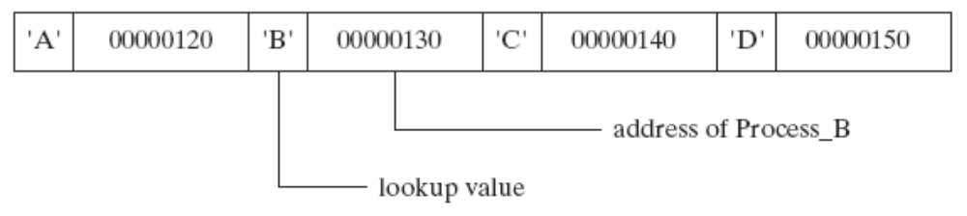
Table-Driven Selection (3 of 4)
Table of Procedure Offsets:
Irvine, Kip R. Assembly Language for x86 Processors 7/e, 2015.

Slide 64
Table-Driven Selection (4 of 4)
Step 2: Use a loop to search the table. When a match is found, call the procedure offset stored in the current table entry:
mov ebx,OFFSET CaseTable ; point EBX to the table
mov ecx,NumberOfEntries ; loop counter
L1: cmp al,[ebx] ; match found?
jne L2 ; no: continue
call NEAR PTR [ebx + 1] ; yes: call the procedure
call WriteString ; display message
call Crlf
jmp L3 ; and exit the loop
L2: add ebx,EntrySize ; point to next entry
loop L1 ; repeat until ECX = 0
L3:
required for procedure pointers
Irvine, Kip R. Assembly Language for x86 Processors 7/e, 2015.

Slide 65
What's Next
Boolean and Comparison Instructions
Conditional Jumps
Conditional Loop Instructions
Conditional Structures
Application: Finite-State Machines
Conditional Control Flow Directives
Irvine, Kip R. Assembly Language for x86 Processors 7/e, 2015.

Slide 66
Application: Finite-State Machines
A finite-state machine (FSM) is a graph structure that changes state based on some input. Also called a state-transition diagram.
We use a graph to represent an FSM, with squares or circles called nodes, and lines with arrows between the circles called edges.
Irvine, Kip R. Assembly Language for x86 Processors 7/e, 2015.

Slide 67
Application: Finite-State Machines
A FSM is a specific instance of a more general structure called a directed graph.
Three basic states, represented by nodes:
  Start state
  Terminal state(s)
  Nonterminal state(s)
Irvine, Kip R. Assembly Language for x86 Processors 7/e, 2015.

Slide 68
Finite-State Machine
Accepts any sequence of symbols that puts it into an accepting (final) state
Can be used to recognize, or validate a sequence of characters that is governed by language rules (called a regular expression)
Advantages:
  Provides visual tracking of program's flow of control
  Easy to modify
  Easily implemented in assembly language
Irvine, Kip R. Assembly Language for x86 Processors 7/e, 2015.

Slide 69
Finite-State Machine Examples
FSM that recognizes strings beginning with 'x', followed by letters 'a'..'y', ending with 'z':
FSM that recognizes signed integers:
Irvine, Kip R. Assembly Language for x86 Processors 7/e, 2015.

Slide 70
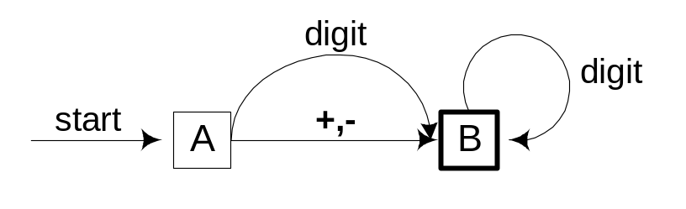
Your Turn . . .
Explain why the following FSM does not work as well for signed integers as the one shown on the previous slide:
Irvine, Kip R. Assembly Language for x86 Processors 7/e, 2015.

Slide 71
Implementing an FSM
The following is code from State A in the Integer FSM:
StateA:
call Getnext ; read next char into AL
cmp al,'+' ; leading + sign?
je StateB ; go to State B
cmp al,'-' ; leading - sign?
je StateB ; go to State B
call IsDigit ; ZF = 1 if AL = digit
jz StateC ; go to State C
call DisplayErrorMsg ; invalid input found
jmp Quit
View the Finite.asm source code.
Irvine, Kip R. Assembly Language for x86 Processors 7/e, 2015.

Slide 72
IsDigit Procedure
Receives a character in AL. Sets the Zero flag if the character is a decimal digit.
IsDigit PROC
cmp al,'0' ; ZF = 0
jb ID1
cmp al,'9' ; ZF = 0
ja ID1
test ax,0 ; ZF = 1
ID1: ret
IsDigit ENDP
Irvine, Kip R. Assembly Language for x86 Processors 7/e, 2015.

Slide 73
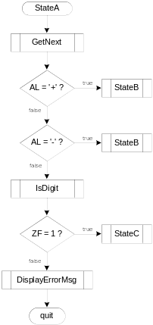
Flowchart of State A
State A accepts a plus or minus sign, or a decimal digit.
Irvine, Kip R. Assembly Language for x86 Processors 7/e, 2015.

Slide 74
Your Turn . . .
Draw a FSM diagram for hexadecimal integer constant that conforms to MASM syntax.
Draw a flowchart for one of the states in your FSM.
Implement your FSM in assembly language. Let the user input a hexadecimal constant from the keyboard.
Irvine, Kip R. Assembly Language for x86 Processors 7/e, 2015.

Slide 75
What's Next
Boolean and Comparison Instructions
Conditional Jumps
Conditional Loop Instructions
Conditional Structures
Application: Finite-State Machines
Conditional Control Flow Directives
Irvine, Kip R. Assembly Language for x86 Processors 7/e, 2015.

Slide 76
Creating IF Statements
Runtime Expressions
Relational and Logical Operators
MASM-Generated Code
.REPEAT Directive
.WHILE Directive
Irvine, Kip R. Assembly Language for x86 Processors 7/e, 2015.

Slide 77
Runtime Expressions
.IF, .ELSE, .ELSEIF, and .ENDIF can be used to evaluate runtime expressions and create block-structured IF statements.
Examples:
.IF eax > ebx
mov edx,1
.ELSE
mov edx,2
.ENDIF
.IF eax > ebx && eax > ecx
mov edx,1
.ELSE
mov edx,2
.ENDIF
MASM generates "hidden" code for you, consisting of code labels, CMP and conditional jump instructions.
Irvine, Kip R. Assembly Language for x86 Processors 7/e, 2015.

Slide 78
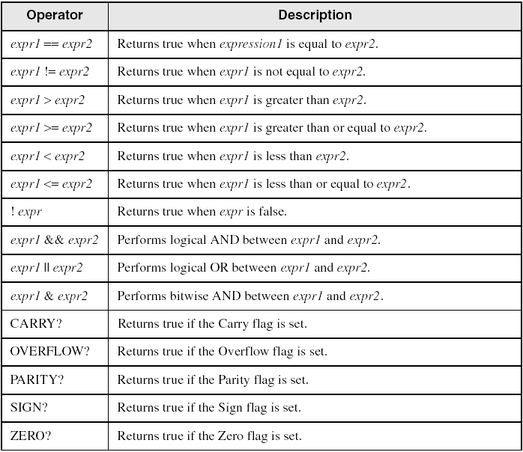
Relational and Logical Operators
Irvine, Kip R. Assembly Language for x86 Processors 7/e, 2015.

Slide 79
Signed and Unsigned Comparisons
.data
val1 DWORD 5
result DWORD ?
.code
mov eax,6
.IF eax > val1
mov result,1
.ENDIF
Generated code:
mov eax,6
cmp eax,val1
jbe @C0001
mov result,1
@C0001:
MASM automatically generates an unsigned jump (JBE) because val1 is unsigned.
Irvine, Kip R. Assembly Language for x86 Processors 7/e, 2015.

Slide 80
Signed and Unsigned Comparisons
.data
val1 SDWORD 5
result SDWORD ?
.code
mov eax,6
.IF eax > val1
mov result,1
.ENDIF
Generated code:
mov eax,6
cmp eax,val1
jle @C0001
mov result,1
@C0001:
MASM automatically generates a signed jump (JLE) because val1 is signed.
Irvine, Kip R. Assembly Language for x86 Processors 7/e, 2015.

Slide 81
Signed and Unsigned Comparisons
.data
result DWORD ?
.code
mov ebx,5
mov eax,6
.IF eax > ebx
mov result,1
.ENDIF
Generated code:
mov ebx,5
mov eax,6
cmp eax,ebx
jbe @C0001
mov result,1
@C0001:
MASM automatically generates an unsigned jump (JBE) when both operands are registers . . .
Irvine, Kip R. Assembly Language for x86 Processors 7/e, 2015.

Slide 82
Signed and Unsigned Comparisons
.data
result SDWORD ?
.code
mov ebx,5
mov eax,6
.IF SDWORD PTR eax > ebx
mov result,1
.ENDIF
Generated code:
mov ebx,5
mov eax,6
cmp eax,ebx
jle @C0001
mov result,1
@C0001:
. . . unless you prefix one of the register operands with the SDWORD PTR operator. Then a signed jump is generated.
Irvine, Kip R. Assembly Language for x86 Processors 7/e, 2015.

Slide 83
.REPEAT Directive
Executes the loop body before testing the loop condition associated with the .UNTIL directive.
Example:
; Display integers 1 – 10:
mov eax,0
.REPEAT
inc eax
call WriteDec
call Crlf
.UNTIL eax == 10
Irvine, Kip R. Assembly Language for x86 Processors 7/e, 2015.

Slide 84
.WHILE Directive
Tests the loop condition before executing the loop body The .ENDW directive marks the end of the loop.
Example:
; Display integers 1 – 10:
mov eax,0
.WHILE eax < 10
inc eax
call WriteDec
call Crlf
.ENDW
Irvine, Kip R. Assembly Language for x86 Processors 7/e, 2015.

Slide 85
Summary
Bitwise instructions (AND, OR, XOR, NOT, TEST)
  manipulate individual bits in operands
CMP – compares operands using implied subtraction
  sets condition flags
Conditional Jumps & Loops
  equality: JE, JNE
  flag values: JC, JZ, JNC, JP, ...
  signed: JG, JL, JNG, ...
  unsigned: JA, JB, JNA, ...
  LOOPZ, LOOPNZ, LOOPE, LOOPNE
Flowcharts – logic diagramming tool
Finite-state machine – tracks state changes at runtime
Irvine, Kip R. Assembly Language for x86 Processors 7/e, 2015.

Slide 86
Exercise
1
3
7
11
Irvine, Kip R. Assembly Language for x86 Processors 7/e, 2015.

